Slide 1
Optimizing Converged Cisco Networks (ONT)
Cvičenie 1

Slide 2
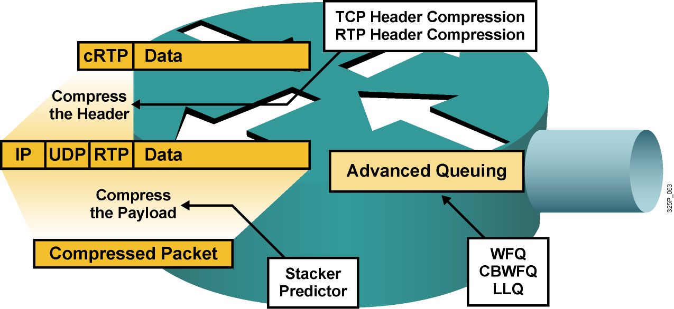
Ako znížiť oneskorenie
Zrýchliť linku (najlepšie, ale aj najdrahšie riešenie)
Dať prioritu dôležitým paketom
Komprimovať obsah rámcov (to však trvá istý čas)
Komprimovať IP hlavičky (detto)
Notes:
When considering solutions to the delay problem, there are two things to note:
Processing and queuing delays are related to devices and are bound to the behavior of the operating system.
Propagation and serialization delays are related to the media.
There are many ways to reduce the delay at a router. Assuming that the router has enough power to make forwarding decisions rapidly, these factors influence most queuing and serialization delays:
Average length of the queue
Average length of packets in the queue
Link bandwidth
Network administrators can accelerate the packet dispatching for delay-sensitive flows:
Increase link capacity: Sufficient bandwidth causes queues to shrink so that packets do not wait long before transmittal. Increasing bandwidth reduces serialization time. This approach can be unrealistic because of the costs that are associated with the upgrade.
Prioritize delay-sensitive packets: This approach can be more cost-effective than increasing link capacity. WFQ, CBWFQ, and LLQ can each serve certain queues first (this is a pre-emptive way of servicing queues).
Reprioritize packets: In some cases, important packets need to be reprioritized when they are entering or exiting a device. For example, when packets leave a private network to transit an Internet service provider (ISP) network, the ISP may require that the packets be reprioritized.
Compress payload: Payload compression reduces the size of packets, which virtually increases link bandwidth. Compressed packets are smaller and take less time to transmit. Compression uses complex algorithms that add delay. If you are using payload compression to reduce delay, make sure that the time that is needed to compress the payload does not negate the benefits of having less data to transfer over the link.
Use header compression: Header compression is not as CPU-intensive as payload compression. Header compression reduces delay when used with other mechanisms. Header compression is especially useful for voice packets that have a bad payload-to-header ratio (relative large header in comparison to the payload), which is improved by reducing the header of the packet (RTP header compression).
By minimizing delay, network administrators can also reduce jitter (delay is more predictable than jitter and easier to reduce).

Slide 3
Efektívne využívanie prenosovej kapacity
Hlas (Najvyššia)
Dáta (Vysoká)
Dáta (Stredná)
Data (Nízka)
Hlas
LLQ
Kompresia RTP hlavičiek
1
1
2
2
4
3
2
1
1
3
3
3
Dáta
CBWFQ
Kompresia TCP hlavičiek
4
4
4
4
Pomocou frontových a kompresných mechanizmov je možné efektívejšie využívať dostupnú prenosovú kapacitu
Hlas: LLQ a kompresia RTP hlavičiek
Interaktívne toky: CBWFQ a kompresia TCP hlavičiek
Notes:
Low-latency queuing (LLQ) je mechanizmus vyvinutý priamo firmou Cisco, cieľom bolo do mechanizmu CB-WFQ priniesť takú formu ukladania a vyberania paketov z front aby hlasové pakety dostali striktnú prioritu - strict priority queuing (PQ) – pošlú sa ako prvé.
TCP header compression - navrhol pán Jacobson, kompresia hlavičiek TCP/IP je špecifikovaná v RFC 1144, neskôr sa aplikovala táto technika aj na kompresiu RTP hlavičiek

Slide 4
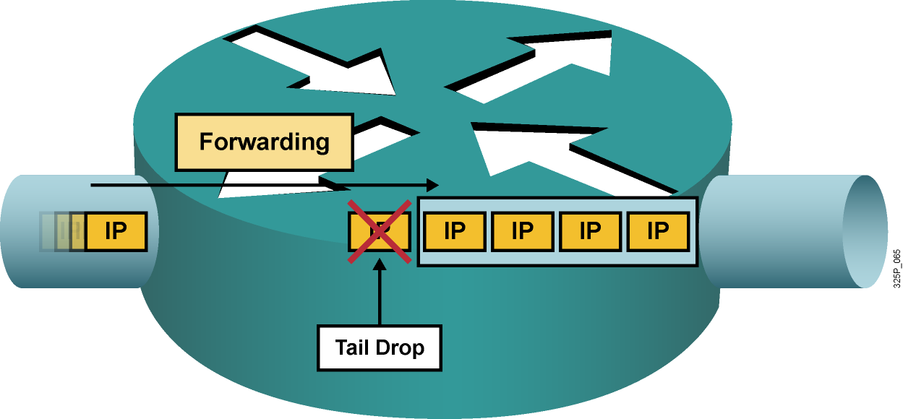
Druhy strát paketov
Straty typu „tail drop“ nastávajú, keď je výstupný front plný. Tieto straty sú bežné a nastávajú pri zahltení výstupného rozhrania
Iné druhy strát sú obvykle spôsobené zahltením na vstupnom rozhraní, pomalým procesorom či chybami pri prenose. Tieto chyby sa často dajú odstrániť upgradom hardvéru
Notes:
This graphic illustrates a full interface output queue, which causes newly arriving packets to be dropped. The term that is used for such drops is “output drop” or “tail drop” (packets are dropped at the tail of the queue).
Routers might also drop packets for other less common reasons:
Input queue drop: The main CPU is busy and cannot process packets (the input queue is full).
Ignore: The router runs out of buffer space.
Overrun: The CPU is busy and cannot assign a free buffer to the new packet.
Frame errors: The hardware detects an error in a frame; for example, cyclic redundancy checks (CRCs), runt, and giant.

Slide 5
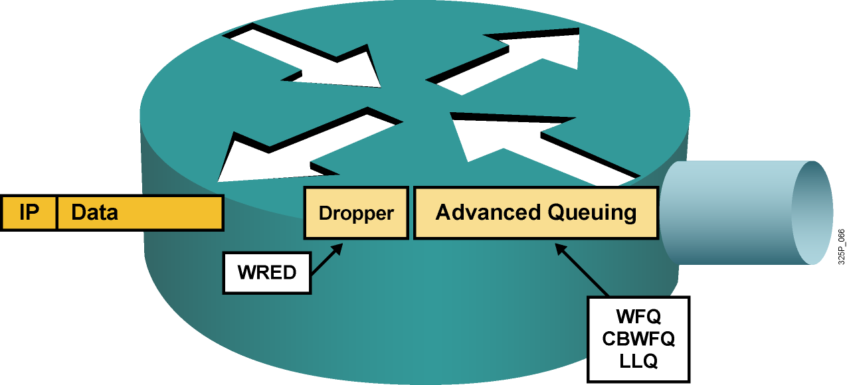
Predchádzanie stratám
Zrýchliť linku (najlepšie, ale aj najdrahšie riešenie)
Garantovať dostatočné pásmo pre citlivé pakety
Predchádzať zahlteniu náhodným zahadzovaním menej dôležitých paketov ešte skôr, než dôjde k zahlteniu
Notes:
Packet loss is usually the result of congestion on an interface. Most applications that use TCP experience slowdown because TCP automatically adjusts to network congestion. Dropped TCP segments cause TCP sessions to reduce their window sizes. Some applications do not use TCP and cannot handle drops (fragile flows).
These approaches prevent drops in sensitive applications:
Increase link capacity to ease or prevent congestion.
Guarantee enough bandwidth and increase buffer space to accommodate bursts of traffic from fragile flows. There are several mechanisms available in Cisco IOS QoS software that can guarantee bandwidth and provide prioritized forwarding to drop-sensitive applications.
Prevent congestion by dropping lower-priority packets before congestion occurs. Cisco IOS QoS provides queuing mechanisms that start dropping lower-priority packets before congestion occurs.

Slide 6
Nástroje pre poskytovanie QoS
Cvičenie 2
Klasifikácia
Identifikácia toku alebo triedy prevádzky
Značkovanie (Marking)
Vyznačenie identifikovaného toku alebo triedy prevádzky
Predchádzanie zahlteniu (Congestion Avoidance)
Tail Drop, Random Early Detection, Weighted RED
Riešenie zahltenia (Congestion Management)
Plánovacie mechanizmy pre obsluhu frontov
Tvarovanie a obmedzovanie prevádzky (Shaping, Policing)
Mechanizmy efektívnosti linky (Link Efficiency Mechanisms)
Link Fragmentation and Interleaving
On-the-fly kompresia hlavičiek alebo tiel paketov

Slide 7
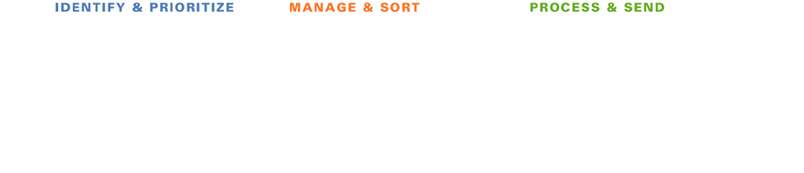







Ako QoS nástroje pracujú?
Klasifikácia a značkovanie
Ukladanie do frontov (Selektívne) zahadzovanie
Činnosti po uložení do frontu
Notes:
In this illustration, the packages on the conveyer belt represent data packets moving through the network.
As packets move through each phase, they are identified and prioritized, then managed and sorted, and finally processed and sent.
As the packets are identified, they are sorted into separate queues. Notice how some packets receive priority (more of these packets are processed over time), and some packets are selectively dropped.
In the next lessons, we will examine in detail the mechanisms used to support these processes.

Slide 8
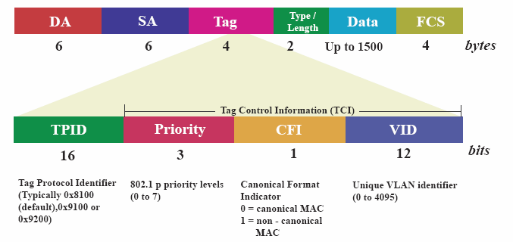
Modely poskytovania QoS
802.1p priorita v L2
DEI - Drop eligible indicator
Notes:
802.1p priorita je umiestnená v hlavičke L2 eht rámca.
Používa sa keď nechceme/nemôžeme analyzovať L3 hlavičky paketu ale potrebujeme zabezpečiť QoS v L2 prostredí
4-bajtové pole 802.1Q hlavičky obsahuje 2-bajtové TPID (Tag Protocol Identifier valued as 0x8100) and 2-byte TCI (Tag Control Information).
Tag protocol identifier (TPID): a 16-bit field set to a value of 0x8100 in order to identify the frame as an IEEE 802.1Q-tagged frame. This field is located at the same position as the EtherType/length field in untagged frames, and is thus used to distinguish the frame from untagged frames.
Drop eligible indicator (DEI): a 1-bit field. (formerly CFI^{[note 1][4]}) May be used separately or in conjunction with PCP to indicate frames eligible to be dropped in the presence of congestion.^{[5]}
VLAN identifier (VID): a 12-bit field specifying the VLAN to which the frame belongs. The hexadecimal values of 0x000 and 0xFFF are reserved. All other values may be used as VLAN identifiers, allowing up to 4,094 VLANs. The reserved value 0x000 indicates that the frame does not carry a VLAN ID; in this case, the 802.1Q tag specifies only a priority and is referred to as a priority tag. On bridges, VID 0x001 (the default VLAN ID) is often reserved for a management VLAN; this is vendor-specific. The VID value 0xFFF is reserved for implementation use; it must not be configured or transmitted. 0xFFF can be used to indicate a wildcard match in management operations or filtering database entries.^{[6]}

Slide 9
Modely poskytovania kvality služby
Model | Popis
Best effort | Bez riadenia kvality služby. Vhodné, ak nie je dôležité, kedy alebo v akom poradí budú pakety doručené.
Integrated Services (IntServ) | Aplikácie oznamujú sieti, aké QoS parametre požadujú pre ich správnu činnosť.
Differentiated Services (DiffServ) | Sieť rozoznáva triedy prevádzky, ktoré vyžadujú osobitné QoS parametre.
Notes:
IP without QoS provides best effort service:
All packets are treated equally
Bandwidth is unpredictable
Delay and jitter are unpredictable
Cisco IOS Software supports two fundamental Quality of Service architectures: Differentiated Services (DiffServ) and Integrated Services (IntServ).
In the DiffServ model a packet's "class" can be marked directly in the packet, which contrasts with the IntServ model where a signaling protocol is required to tell the routers which flows of packets requires special QoS treatment. DiffServ achieves better QoS scalability, while IntServ provides a tighter QoS mechanism for real-time traffic. These approaches can be complimentary and are not mutually exclusive.

Slide 10
Klasifikačné nástroje IP Precedence a DiffServ Code Point
Version Length
ToS
Byte
Len
ID
Offset
TTL
Proto
FCS
IP SA
IP DA
Data
IPv4 Paket
7
6
5
4
3
2
1
0
Štandard IPv4
IP Precedence
Unused
DiffServ Code Point (DSCP)
IP ECN
Rozšírenie DiffServ
IPv4: tri najvyššie bity ToS bajtu sa nazývajú IP Precedence (IPP). Ostatné bity boli niekoľkokrát predefinované (Delay, Throughput, Reliability, Monetary cost)
DiffServ: šesť najvyšších bitov ToS bajtu sa nazývajú DiffServ Code Point (DSCP). Zvyšné dva bity sa využívajú na explicitnú informáciu o zahltení (ECN). Hodnota DSCP poľa sa nazýva codepoint
Hodnoty DSCP sú spätne kompatibilné s hodnotami IP Precedence
Notes:
• IP Type of Service Byte—As Layer 2 media often changes as packets traverse from source to destination, a more ubiquitous classification would occur at Layer 3. The second byte in an IPv4 packet is the Type of Service (ToS) byte. The first three bits of the ToS byte alone are referred to as the IP Precedence (IPP) bits. These same three bits, in conjunction with the next three bits, are known collectively as the DSCP bits.
The IP Precedence bits, like 802.1p CoS bits, allow for only 8 values of marking (0-7).
IPP values 6 and 7 are generally reserved for network control traffic (such as routing).
IPP value 5 is recommended for voice.
IPP value 4 is shared by video conferencing and streaming video.
IPP value 3 is for voice-control.
IPP values 1 and 2 can be used for data applications.
IPP value 0 is the default marking value.
Many enterprises find IPP marking to be overly restrictive and limiting, favoring instead the 6-Bit/64-value DSCP marking model.

Slide 11
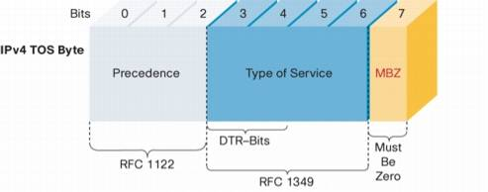
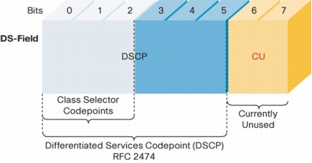
IP ToS a DS pole v IP hlavičke
Notes:
To support DiffServ, the IPv4 Type of Service (ToS) octet has been redefined from the 3-bit IP-precedence to a 6-bit DSCP field.
Prior to DiffServ, IP networks could use the Precedence field in the Type of Service (TOS) byte of the IP header to mark priority traffic.
As the TOS byte and IP precedence was not widely used, the IETF agreed to reuse the TOS byte as the DS field for DiffServ networks. In order to maintain backward compatibility with network devices that still use the Precedence field, DiffServ defines the Class Selector PHB.
The Class Selector codepoints are of the form 'xxx000'. The first three bits are the IP precedence bits. Each IP precedence value can be mapped into a DiffServ class. If a packet is received from a non-DiffServ aware router that used IP precedence markings, the DiffServ router can still understand the encoding as a Class Selector codepoint.

Slide 12
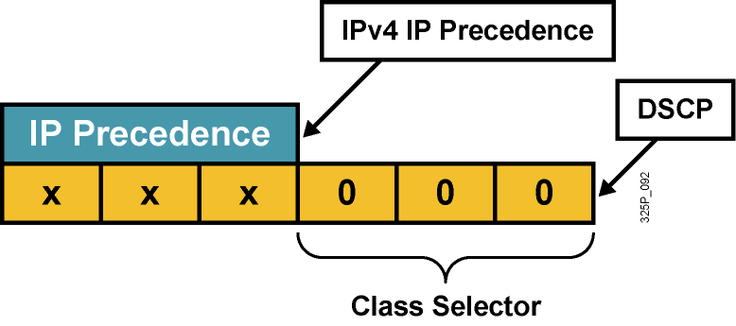
Kompatibilita IP Precedence a DSCP
Pre zachovanie kompatibility s IP Precedence (RFC 1812) boli zavedené tzv. Class Selector codepoints v tvare xyz000 s názvom CS0 až CS7
Odlišuje pravdepodobnosť včasného vybavenia paketu:
(xyz000) >= (abc000), ak xyz >= abc
Napríklad, ak má paket DSCP codepoint 011000 (CS3), má väčšiu pravdepodobnosť včasného odoslania než paket s DSCP 001000 (CS1)
Notes:
RFC 2474 replaced the ToS field with the DiffServ field, in which a range of eight values (class selector) is used for backward compatibility with IP precedence. There is no compatibility with other bits used by the ToS field.
The class selector Per Hop Behavior (PHB) was defined to provide backward compatibility for DSCP with ToS-based IP precedence.
RFC 1812 simply prioritizes packets according to the precedence value. In this sense, the PHB is defined as the probability of timely forwarding.
For example, consider a service provider offering so-called “Olympic” service classes (Gold, Silver, and Bonze) so that packets in the gold class experience lighter load, and thus have greater probability for timely forwarding, than packets assigned to the silver class. Packets with higher IP precedence should be (on average) forwarded in less time than packets with lower IP precedence.
The last 3 bits of the DSCP (bits 2 to 4) set to 0 identify a class-selector PHB.

Slide 13
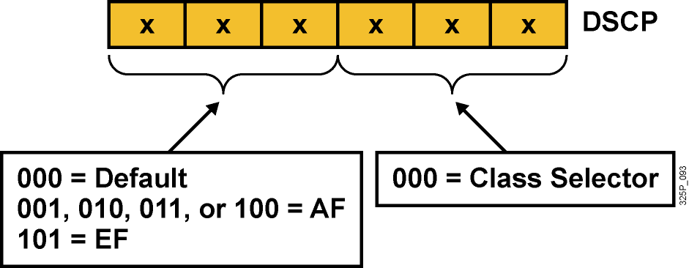
Per-Hop Behavior – PHB
PHB je spôsob obsluhy konkrétnej triedy prevádzky na danom uzle
DSCP vlastne vyberá PHB pozdĺž siete
Default PHB (FIFO, tail drop)
Class-selector PHB (IP precedence)
EF PHB (Expedited Forwarding)
AF PHB (Assured Forwarding)
Notes:
Now that packets can be marked using the DSCP, how do we provide meaningful CoS, and provide the QoS that is needed?
First, the collection of packets that have the same DSCP value (also called a codepoint) in them, and crossing in a particular direction is called a Behavior Aggregate (BA)…more about this later. Packets from multiple applications/sources could belong to the same BA.
Formally, RFC-2475 defines a Per Hop Behavior (PHB) as the externally observable forwarding behavior applied at a DS-compliant node to a DS BA. In more concrete terms, a PHB refers to the packet scheduling, queuing, policing, or shaping behavior of a node on any given packet belonging to a BA, and as configured by a Service Level Agreement (SLA) or policy.
To date, four standard PHBs are available to construct a DiffServ-enabled network and achieve coarse-grained, end-to-end CoS and QoS: Default, EF, AF and Class-selector.
PHBs are defined in terms of behavior characteristics relevant to service provisioning policies, and not in terms of particular implementation mechanisms. In general, a variety of implementation mechanisms may be suitable for implementing a particular PHB group.
The DiffServ architecture defines the DiffServ (DS) field to make per-hop behavior (PHB) decisions about packet classification and traffic conditioning functions, such as metering, marking, shaping, and policing.
The Default PHB (Defined in RFC-2474)
The default PHB specifies that a packet marked with a DSCP value (recommended) of `000000' gets the traditional best effort service from a DS-compliant node (a network node that complies to all the core DiffServ requirements). Also, if a packet arrives at a DS-compliant node and its DSCP value is not mapped to any of the other PHBs, it will get mapped to the default PHB.
Class-Selector PHBs (Defined in RFC-2474)
To preserve backward compatibility with the IP-precedence scheme, DSCP values of the form `xxx000,' where x is either 0 or 1, are defined. These codepoints are called class-selector codepoints. The PHB associated with a class-selector codepoint is a class-selector PHB. These PHBs retain almost the same forwarding behavior as nodes that implement IP-precedence based classification and forwarding. For example, packets with a DSCP value of `110000' (IP-precedence 110) have a preferential forwarding treatment (scheduling, queuing, etc.) as compared to packets with a DSCP value of `100000' (IP-precedence 100). These PHBs ensure that DS-compliant nodes can co-exist with IP-precedence aware nodes, with the exception of the DTS bits.
EF PHB (described in following slides)
AF PHB (described in following slides)

Slide 14
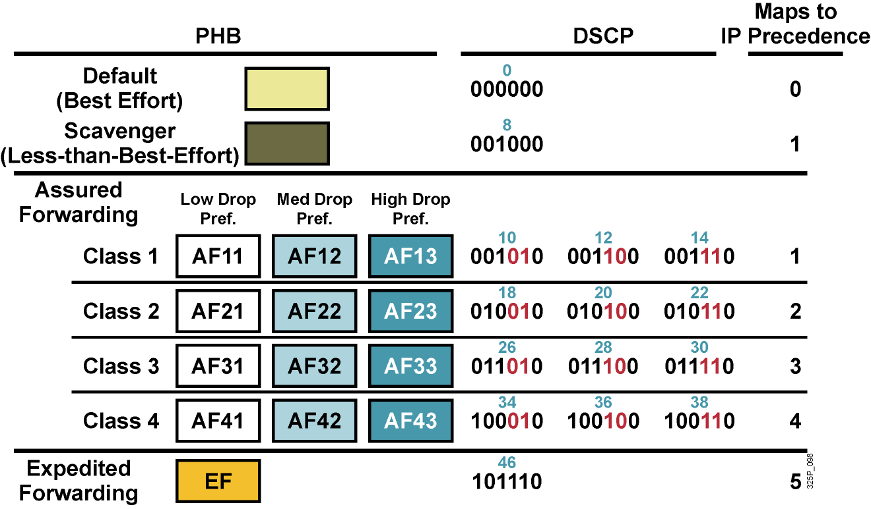
Štandardné PHB skupiny
Notes:
Standard PHBs are available to construct a DiffServ-enabled network and achieve coarse-grained, end-to-end CoS and QoS.
Default PHB (as defined in RFC 2474)
AF PHB (as defined in RFC 2597)
EF PHB (as defined in RFC 2598) class-selector PHB (as defined in RFC 2474)

Slide 15
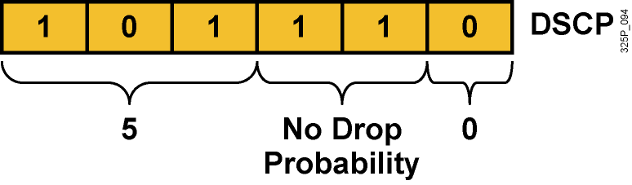
Expedited Forwarding (EF) PHB
EF PHB:
Garantuje tzv. minimum departure rate – právo prednostného odoslania
Garantuje prenosové pásmo vyhradené pre triedu prevádzky s EF
Limituje pásmo pomocou policingu – trieda s EF nemôže prekročiť garantované pridelené pásmo
DSCP codepoint 101110 (46): Pre zariadenia podporujúce len IPP je to precedencia 5:
Bity 5 až 7: 101 = 5 (rovnaké 3 bity použité pre IP Precedence)
Bity 3 a 4: 11 = Bez strát (low delay, high throughput)
Bit 2: Nastavený na 0
Notes:
The Expedited Forwarding (EF) PHB is the key ingredient in DiffServ for providing a low-loss, low-latency, low-jitter, and assured bandwidth service. Applications such as VoIP, video, and online trading programs require a robust network-treatment. EF can be implemented using priority queuing, along with rate limiting on the class (formally, a BA).
Although EF PHB when implemented in a DiffServ network provides a premium service, it should be specifically targeted toward the most critical applications, because if congestion exists, it is not possible to treat all or most traffic as high priority. EF PHB is especially suitable for applications (like VoIP) that require very low packet loss, guaranteed bandwidth, low delay and low jitter.
Packets requiring EF should be marked with DSCP binary value 101110 (46 or 0x2E).
Non-DiffServ-compliant devices regard EF DSCP value 101110 as IP precedence 5 (101). This precedence is the highest user-definable IP precedence and is typically used for delay-sensitive traffic (such as VoIP). Bits 5 to 7 of the EF DSCP value are 101, which matches IP precedence 5 and allows backward compatibility.

Slide 16
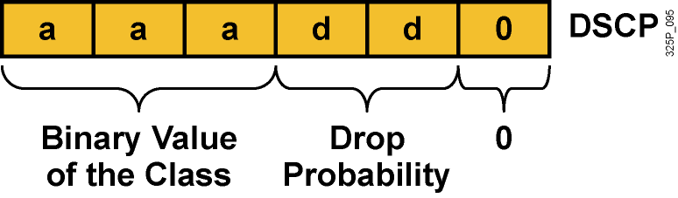
Assured Forwarding (AF) PHB
AF PHB:
Garantuje isté minimálne prenosové pásmo
Umožňuje využiť aj väčie pásmo, ak je momentálne k dispozícii
Štyri základné kategórie: AF1, AF2, AF3 a AF4
DSCP codepoint má tvar aaadd0:
aaa je binárne číslo triedy (1, 2, 3 alebo 4)
dd je pravdepodobnosť zahodenia
Notes:
The AF PHB is identified based on the following:
The AF PHB guarantees a certain amount of bandwidth to an AF class.
The AF PHB allows access to extra bandwidth, if available.
Packets requiring AF PHB should be marked with DSCP value aaadd0, where aaa is the number of the class and dd is the drop probability.
There are four standard AF classes defined: AF1, AF2, AF3, and AF4. Each class should be treated independently and should have allocated bandwidth that is based on the QoS policy.
AF PHB defines a method by which BAs can be given different forwarding assurances. For example, traffic can be divided into gold, silver, and bronze classes, with gold being allocated 50 percent of the available link bandwidth, silver 30 percent, and bronze 20 percent.

Slide 17
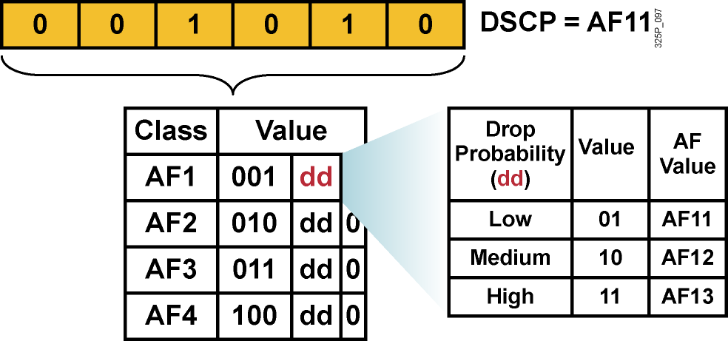
Hodnoty AF PHB
Každá AF trieda využíva 3 DSCP hodnoty
Každá AF trieda sa preposiela nezávisle od ostatných so svojou garantovanou šírkou pásma
Aby sa predišlo zahlteniu, v každej triede sa používajú techniky predchádzania zahlteniu – Weighted RED (WRED)
Ak je daná trieda AFxy, dekadickú hodnotu DSCP vypočítame ako 8x+2y
Notes:
Within each AFx class, it is possible to specify 3 drop precedence values. If there is congestion in a DS-node on a specific link, and packets of a particular AF class (for example AF1) need to be dropped, packets will be dropped such that the probability of drop creates a relationship where AFx1 <= AFx2 <= AFx3.
In other words, packets in AF13 will get dropped before packets in AF12, before packets in AF11. This concept of drop precedence is useful, for example, to penalize flows within a BA that exceed the assigned bandwidth. Packets of these flows could be re-marked by a policer to a higher drop precedence.

Slide 18
Priorita v IPv6

Slide 19
Koľko tried treba?
4/5 Class Model
8 Class Model
11 Class Model
Realtime
Voice
Voice
Interactive-Video
Video
Streaming Video
Call Signaling
Call Signaling
Call Signaling
Critical Data
Network Control
IP Routing
Network Management
Critical Data
Mission-Critical Data
Transactional Data
Bulk Data
Bulk Data
Best Effort
Best Effort
Best Effort
Scavenger
Scavenger
Scavenger
Čas
Notes:
Many enterprises aren’t ready to deploy a complex 11-Class Model, or may never have the need for 11 classes of service.
5-Classes is the recommended model for provisioning QoS for Voice, Video and Data.
Some of these classes can be gradually split into more granular classes, as shown in the diagram, as needed by the network.

Slide 20
Classification and Marking Design Odporúčania pre QoS Baseline Marking
Application
L3 Classification
L2
IPP
PHB
DSCP
CoS
Routing
6
CS6
48
6
Voice
5
EF
46
5
Video Conferencing
4
AF41
34
4
Streaming Video
4
CS4
32
4
Mission-Critical Data
3
AF31*
26
3
Call Signaling
3
CS3*
24
3
Transactional Data
2
AF21
18
2
Network Management
2
CS2
16
2
Bulk Data
1
AF11
10
1
Best Effort
0
0
0
0
Scavenger
1
CS1
8
1
Notes:
Cisco has adopted a new initiative called the “QoS Baseline.” The QoS Baseline is a strategic document designed to unify QoS within Cisco, from enterprise to service provider and from engineering to marketing. The QoS Baseline was written by Cisco's most qualified QoS experts.
The QoS Baseline specifies 11 traffic classes within the enterprise. An important note is that the QoS Baseline is not dictating that every enterprise deploy 11 different traffic classes immediately, but rather it is considering enterprise QoS needs of not only today, but also the foreseeable future. Even if an enterprise needs to provision for only a handful of these 11 classes today, following QoS Baseline recommendations will enable them to leave options open for smoothly provisioning additional traffic classes in the future.
Note: The QoS Baseline recommends marking Call-Signaling to CS3. Currently, however, all Cisco IP Telephony products mark Call-Signaling to AF31. A marking migration from AF31 to CS3 is planned within Cisco, but in the interim it is recommended that both AF31 and CS3 be reserved for Call-Signaling and that Locally-Defined Mission-Critical data applications be marked to DSCP 25. Upon completion of the migration, the QoS Baseline marking recommendations of CS3 for Call-Signaling and AF31 for Locally-Defined Mission-Critical applications should be used. These marking recommendations are more inline with RFC 2597 and RFC 2474.

Slide 21
Sumár DSCP a CS
https://supportforums.cisco.com/document/51426/cisco-qos-baseline-classification-marking-and-mapping-recommendations

